Slide 1
Predictive Models for Pricing at Acme Foods
Analyses and Recommendations

Slide 2
Key Data Points Used in Analysis and Predictive Modeling
Item_Outlet_Sales: Sales of the product in the particular store. This is the target variable to be predicted.
Item_Type : The product’s category (i.e. Dairy, Meat, etc.)
Item_MRP: The product’s ‘Max Retail’ (list) price
Outlet_Size: The size of the store in terms of ground area covered
Outlet_Location_Type : The type of area in which the store is located
Item_Weight: Weight of product
Item_Visibility: The percentage of total display area of all products in a store allocated to the particular product

Slide 3
What problem are we addressing?
Increase revenue in under-performing stores.
Improve customer satisfaction by customizing the sales floor to their needs.
Assist management in determining key areas of opportunity.

Slide 4
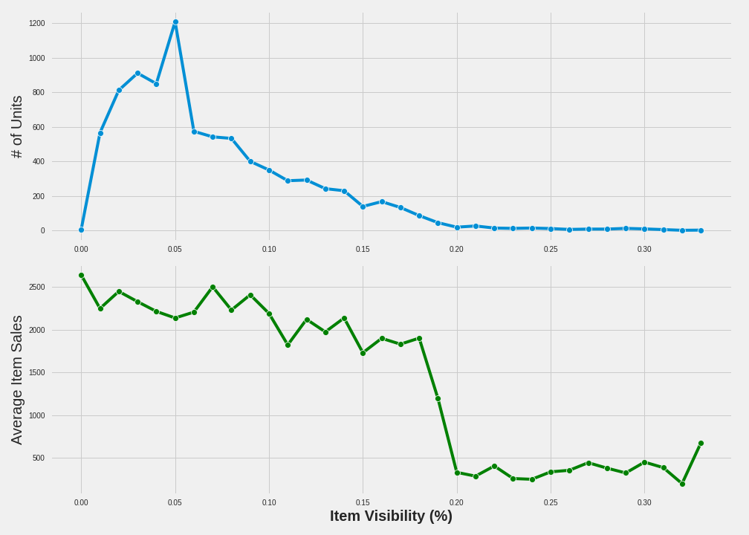
Insights from the Data - Item Visibility and Sales
Too Much on the Shelves
Item visibility for most items is 5% or less, then drops suddenly.
Optimal space: 7% - 18% visibility.
Current utilization: 6.9% average.

Slide 5
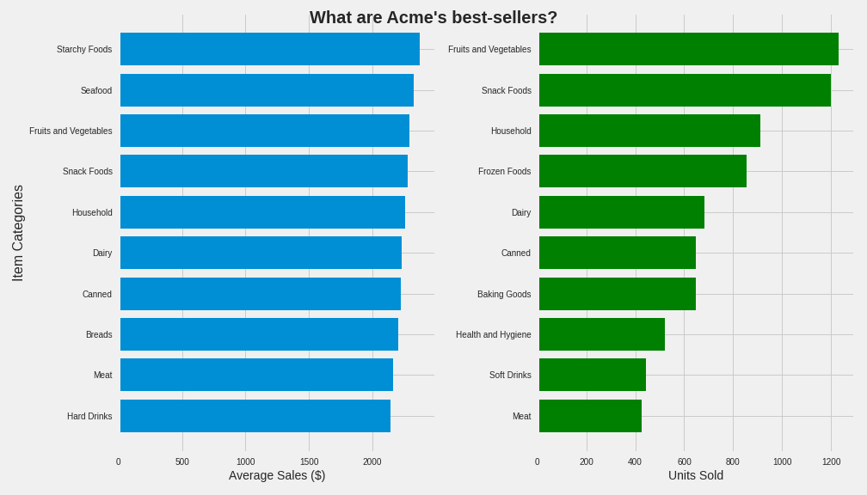
Insights from the Data - Best Selling Categories
Meat, seafood, and starchy foods have high sales averages with significantly fewer stocked units.
‘Fruits and vegetables” and “snack foods” are the only categories that appear in both top fives.

Slide 6
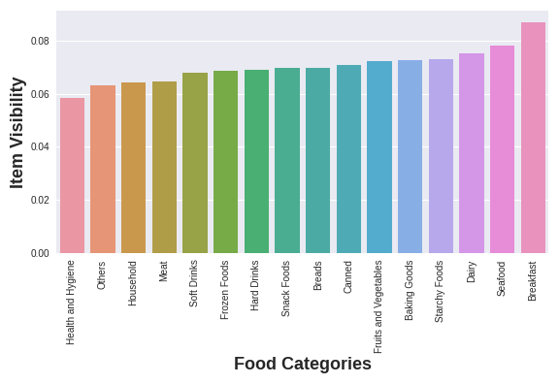
Could Item Visibility Correlate with Overall Sales?
Top 10 Categories (Average Sales)
Starchy Foods 2374.33
Seafood 2326.07
Fruits and Vegetables 2289.01
Snack Foods 2277.32
Household 2258.78
Dairy 2232.54
Canned 2225.19
Breads 2204.13
Meat 2158.98
Hard Drinks 2139.22

Slide 7
Predictive Model Comparison
Model Performance on Test Data (metric: r^2)
Linear Regression model: 56.6% accuracy
Decision Tree model: 59.5% accuracy
Random Forest model: 60.3% accuracy
Recommendation: Using the random forest model will continue to produce the most accurate predictions on this dataset. However, the scores indicate we may need more data to develop a more robust model.

Slide 8
Recommendations
Encourage store managers to increase visibility of top-selling food categories.
Increase stock in top-selling categories: meat, starchy foods, and seafood.
Capture more sales data to help better tune future predictive models.

